Slide 1
React Redux

Slide 2
Defination
Redux is a pattern and library for managing and updating application state, using events called "actions". It serves as a centralized store for state that needs to be used across your entire application, with rules ensuring that the state can only be updated in a predictable fashion.
Redux is not tied to React.
Can be used with React, Angular, Vue or even vanilla JavaScript

Slide 3
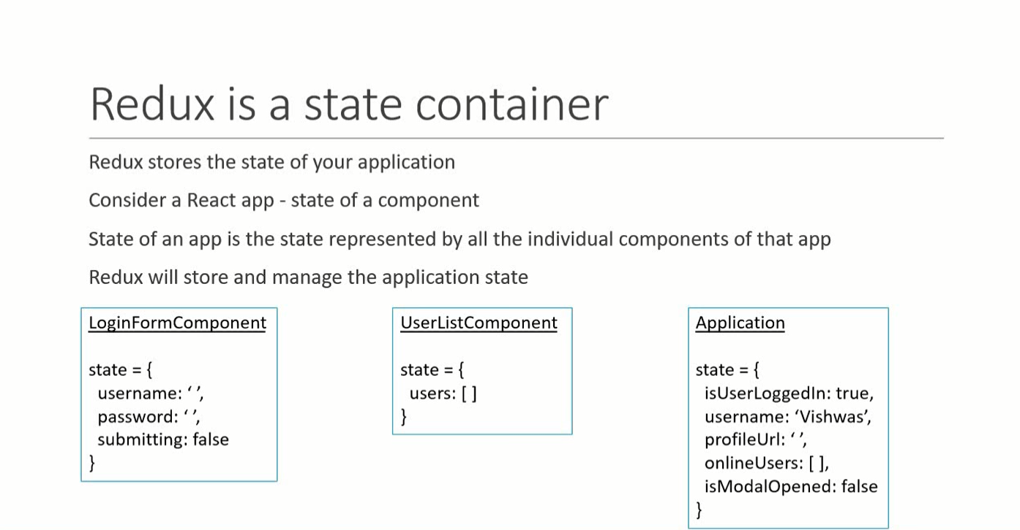

Slide 4
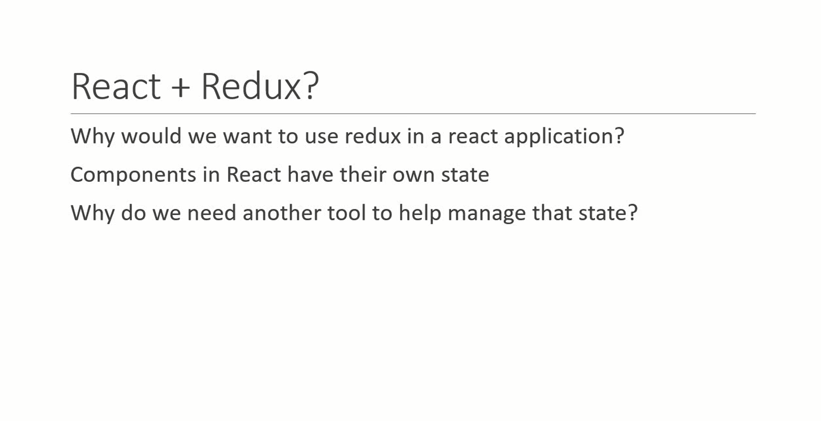

Slide 6
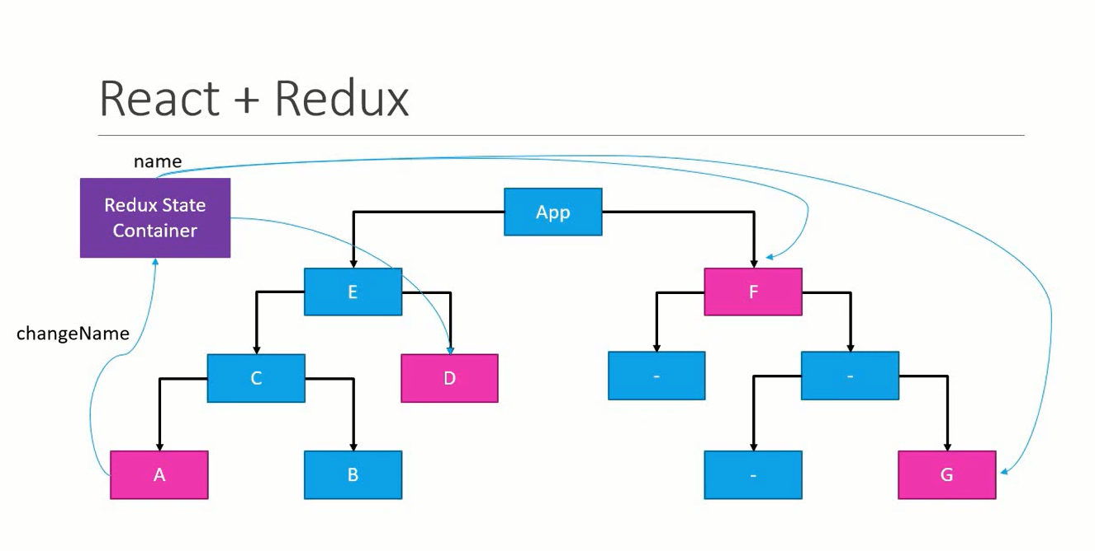

Slide 7
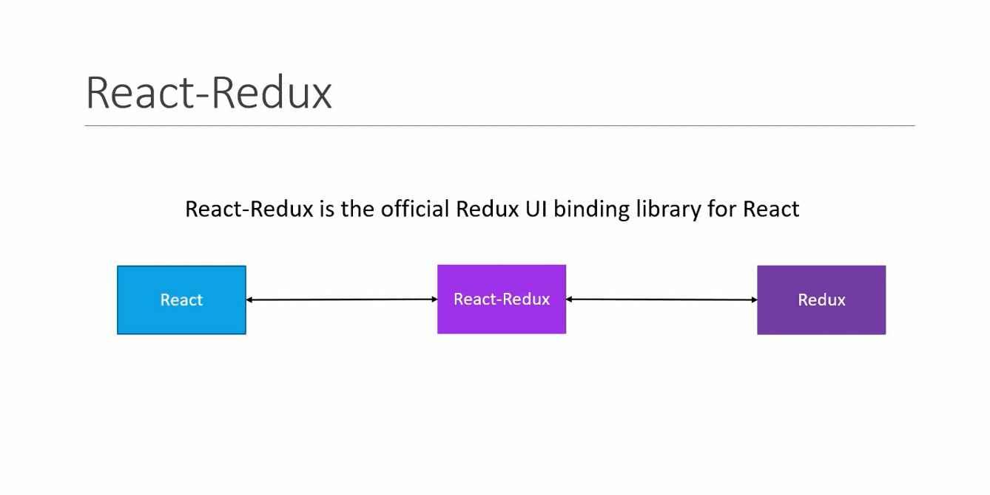

Slide 8
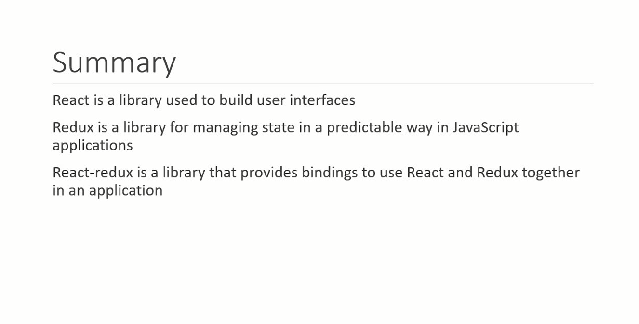

Slide 9
Why Should I Use Redux?
Redux helps you manage "global" state - state that is needed across many parts of your application.
The patterns and tools provided by Redux make it easier to understand when, where, why, and how the state in your application is being updated, and how your application logic will behave when those changes occur.

Slide 10
When Should I Use Redux?
Redux is more useful when:
You have large amounts of application state that are needed in many places in the app
The app state is updated frequently over time
The logic to update that state may be complex
The app has a medium or large-sized codebase, and might be worked on by many people

Slide 11
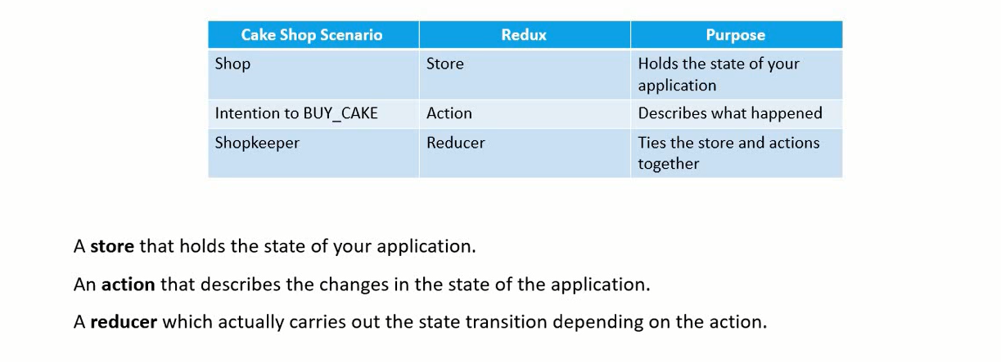
Three principle of redux

Slide 12
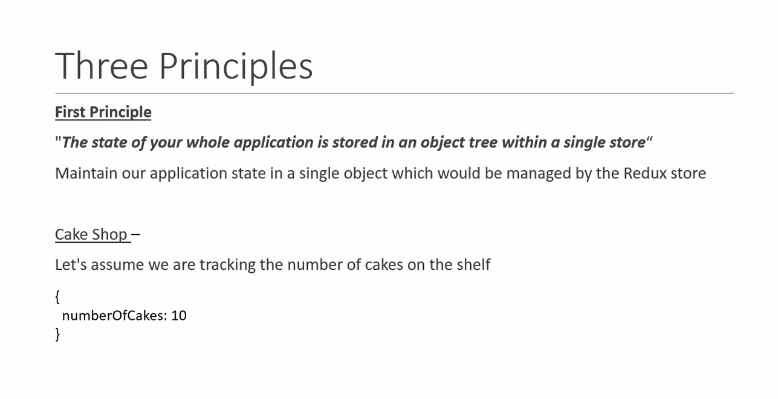

Slide 13
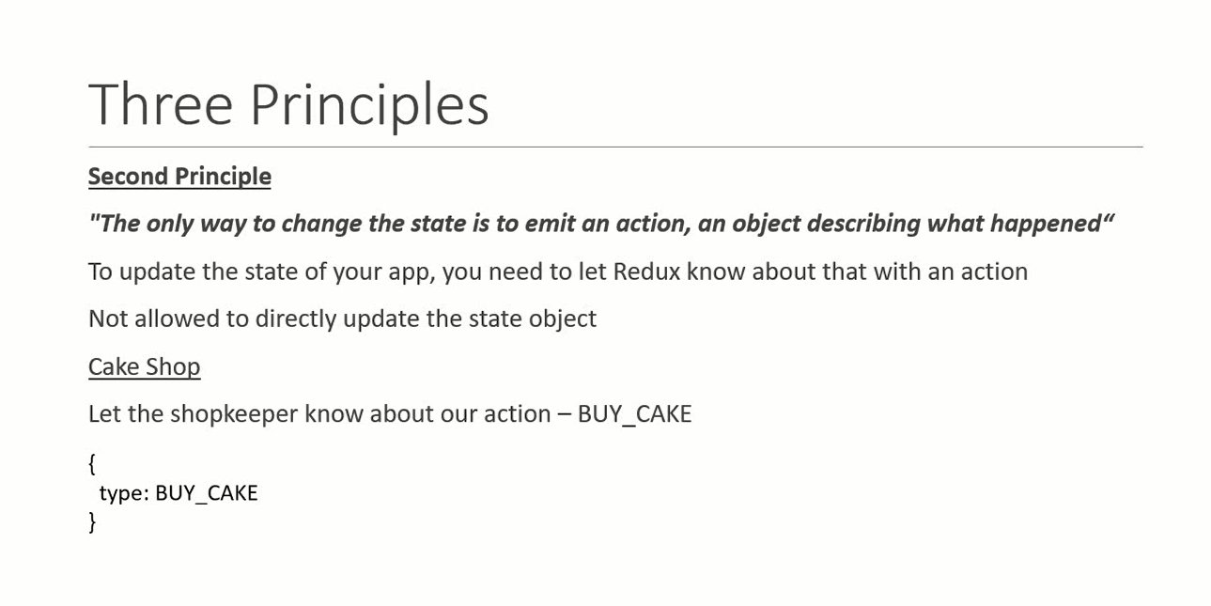

Slide 14
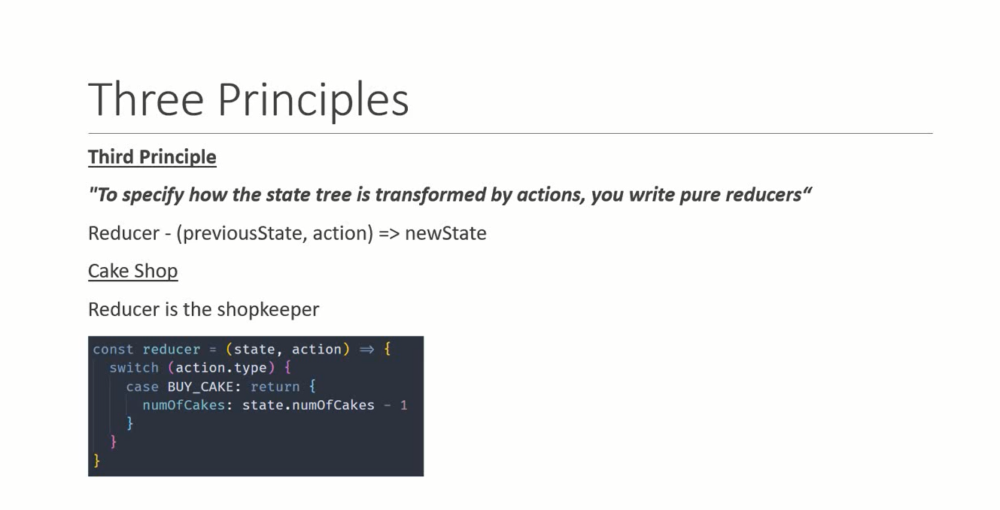

Slide 15
